Slide 1
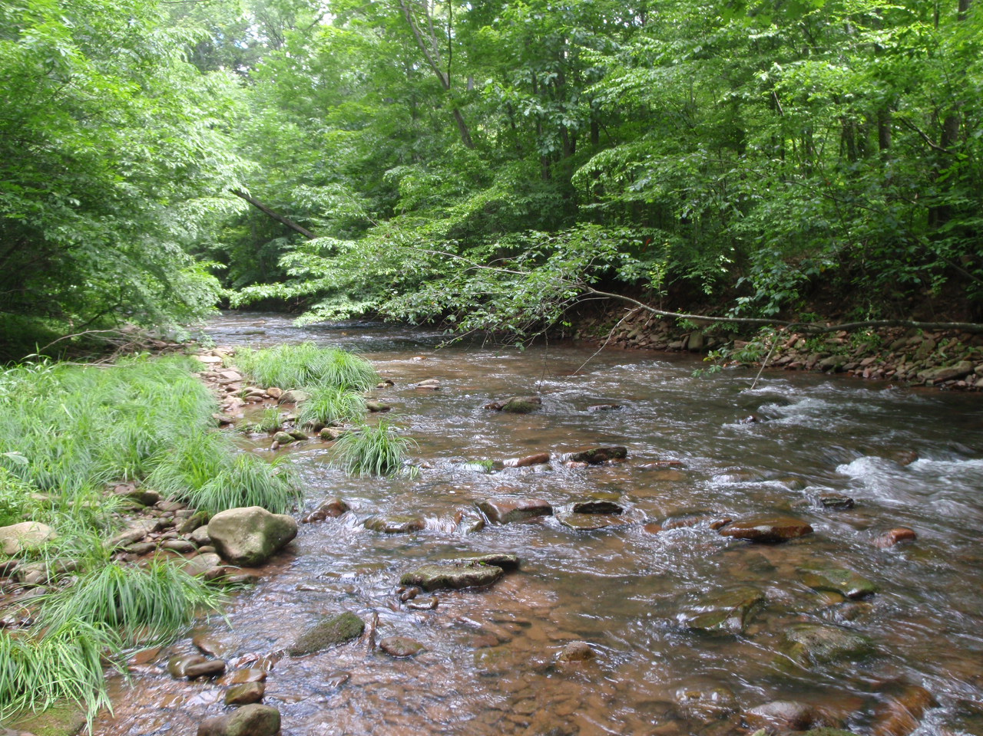
Evaluation of Macroinvertebrate Assemblages in the Marcellus Shale Region of the Susquehanna River Basin, 2011-2013
Luanne Steffy
Susquehanna River Basin Commission
Shale Network Workshop
May 8, 2015

Slide 2

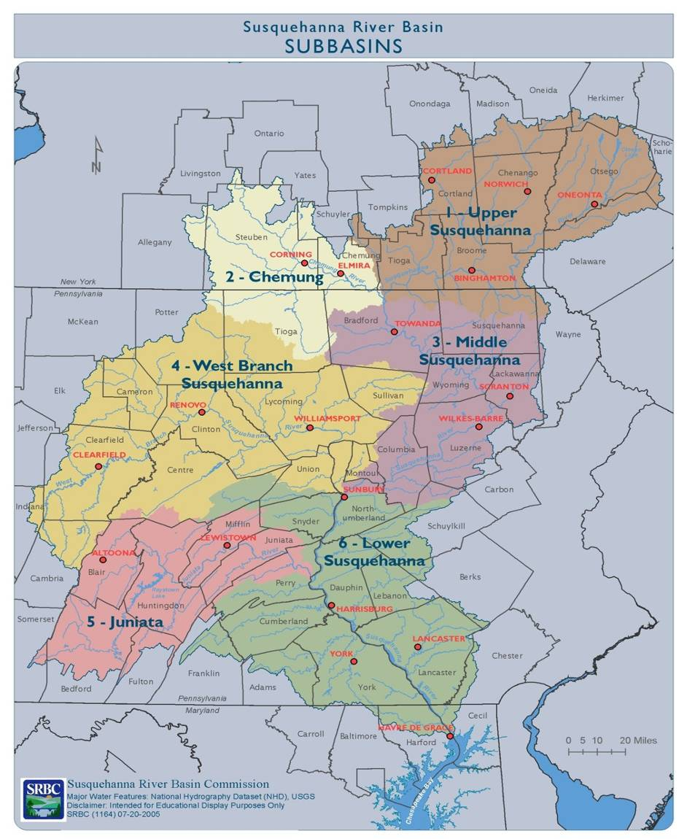
Susquehanna River Basin
The Basin
27,510-square-mile watershed
Comprises 43% of the Chesapeake Bay watershed
4.2 million population
60% forested
32,000+ miles of waterways
The Susquehanna River
444 miles, largest tributary to the Chesapeake Bay
Supplies 18 million gallons a minute to the bay
Natural gas shales under 85% of basin
Notes:
issue at forefront of a lot of our work in past 5 years, very aware, working hard to manage the water resources of the basin as it relates to marcellus/shale gas

Slide 3
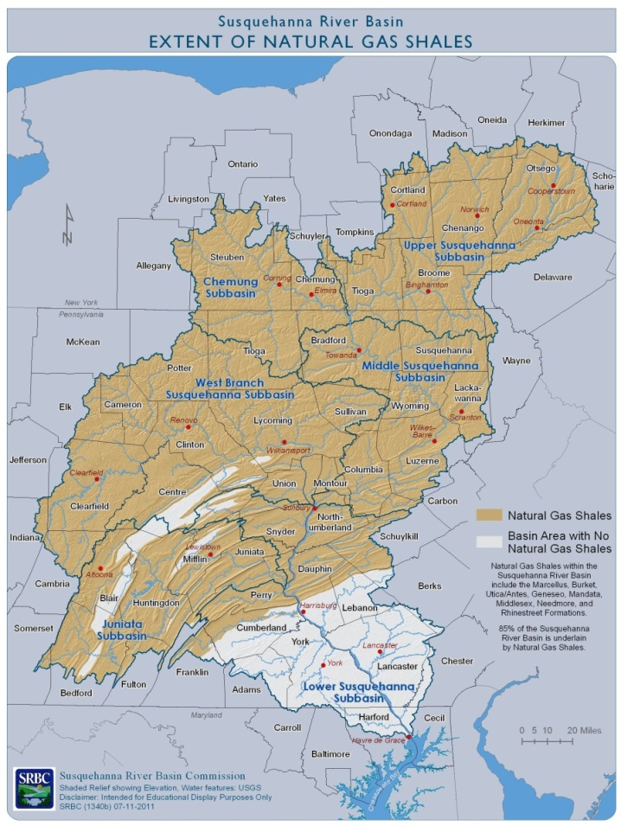
Assessment of Unconventional Gas Development in the Susquehanna River Basin
Compilation of all SRBC program activities covering the shale gas industry through 2013
Four-part Assessment
Water Acquisition
Water Quality
Compliance
Assessment Results/Recommendations
Started – February 2014
Completion – Late Summer 2015
Notes:
Before I jump right in to my talk I would like to take a minute to put in a plug for something SRBC is currently putting together. Its been 5 years and we want to evaluate gas development in the basin in a comprehensive manner. Look for this soon!

Slide 4
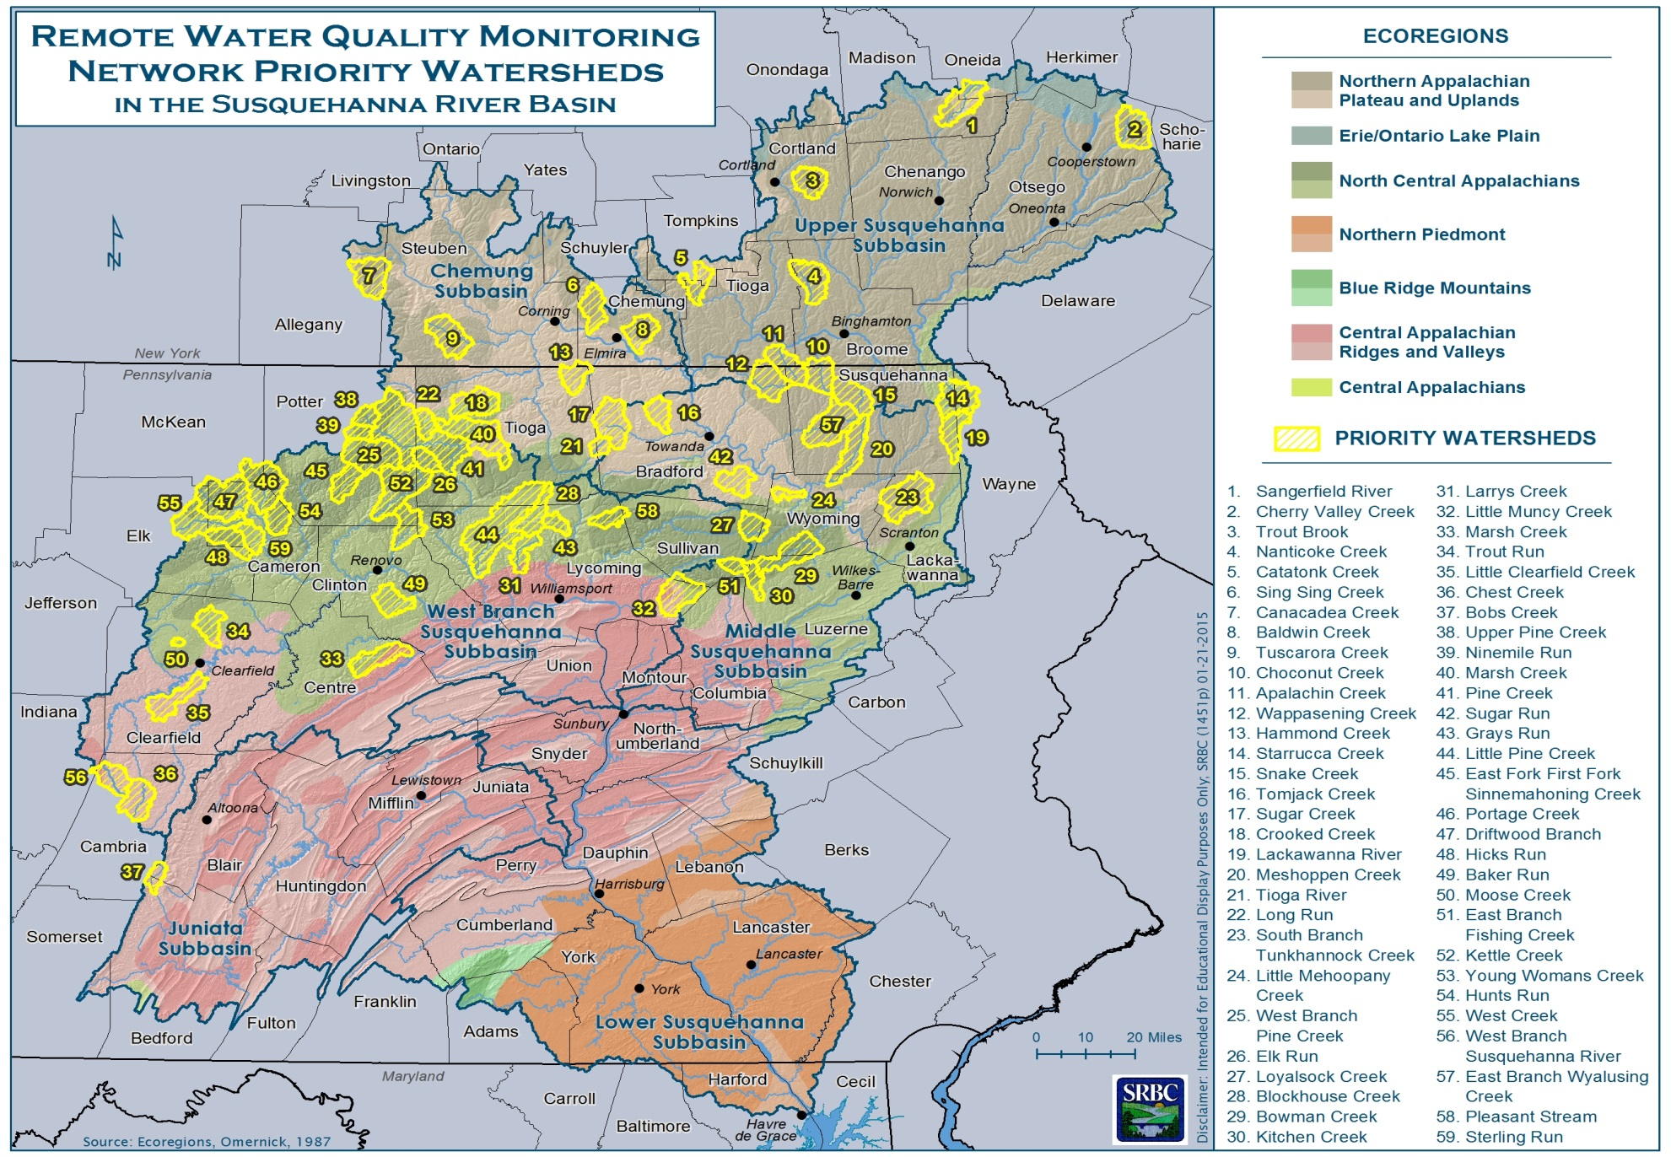
Remote Water Quality Monitoring Network
Notes:
So one of the first things SRBC did in response to Marcellus shale industry was the implementation of the RWQMN. Some familiarity with it…real-time, website, focused on shale areas where drilling was happening or expected plus some where none expected. YSI sondes, temp, DO, cond, pH, turb at 5 min intervals

Slide 5
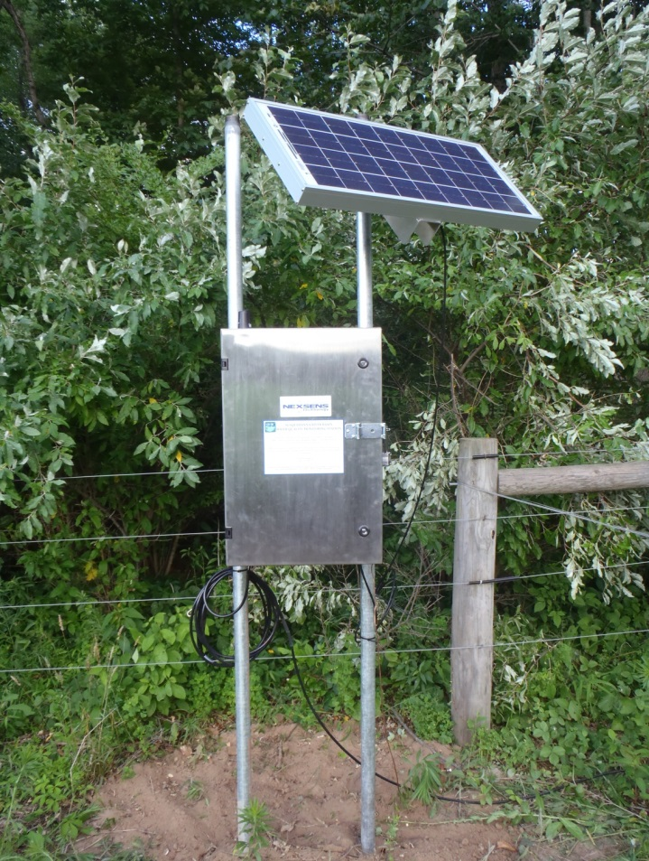
Remote Water Quality Monitoring Network Objectives
Establishing a real-time water quality monitoring network within areas of concern in the Susquehanna River Basin
Establish baseline water quality conditions;
Determine if the natural gas well industry and/or other activities are causing adverse impacts on local water quality;
Form collaborative partnerships to improve monitoring technology and provide educational opportunities;
Enhance protection for water supplies; and
Be responsive to public concerns.
Notes:
These are “official” original objectives

Slide 6
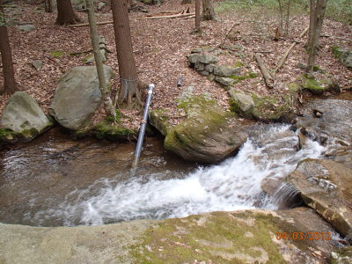
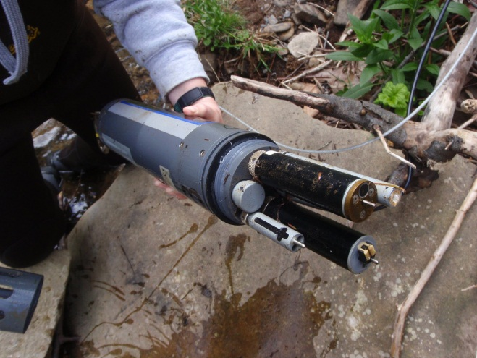
The Evolution of the RWQMN
First monitoring stations deployed – 2010
Macroinvertebrate sampling – 2011
Fish sampling – 2012
Rain gauges and pressure transducers– 2013
Currently, 59 real-time monitoring stations
Many opportunities for data sharing, data usage, overlapping project goals
Notes:
Over the years it has morphed into a broader data collection effort that we think provides many opportunities for wide ranging uses of data. Didymo, sed/turb, eel reintroduction, low flow monitoring, EPA regional climate change efforts

Slide 7
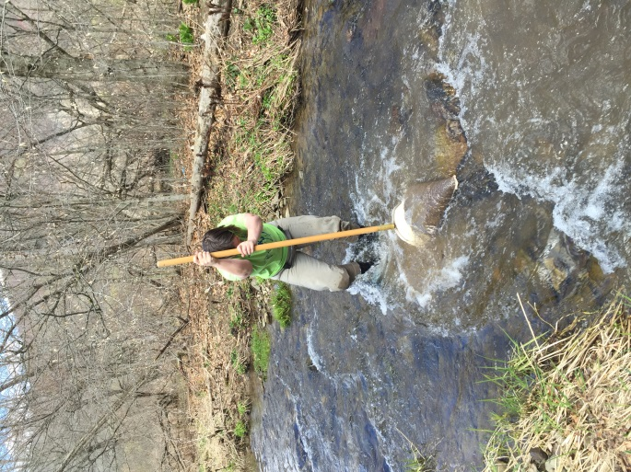
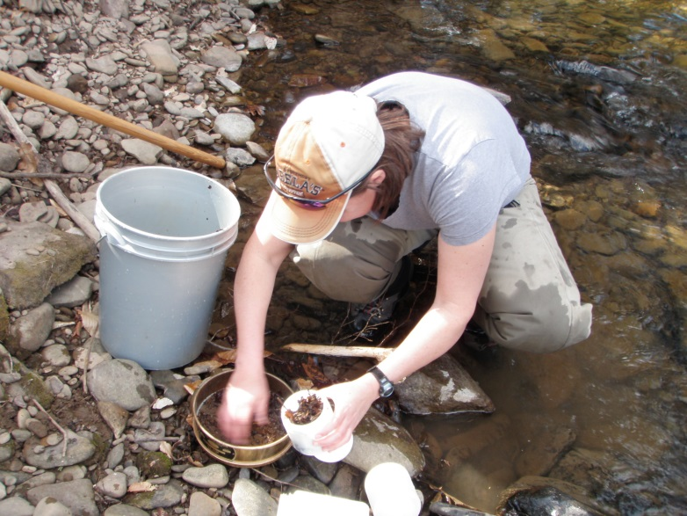
Macroinvertebrate sampling
PADEP Protocol
6 D-frame kicks composited
200 count subsample
identified to genus (Chironomidae to family)
Sampled annually in October
2011: 50 sites sampled (13 in May)
2012: 58 sites sampled
2013: 59 sites sampled
Analysis based on PA IBI, related metrics and community similarity
Notes:
I assume most of you are familiar with the common use of stream macroinvertebrates as bioindicators, reflect water quality and habitat. PA IBI - collection of 6 metrics combined to give one score

Slide 8
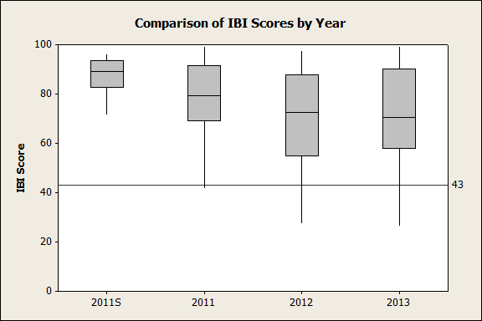
Result #1 – High IBI scores
Sites located in minimally impacted watersheds, with intact macroinvertebrate communities
only 6% of samples scored at or under the definitively impaired score of 43
Notes:
IBI incorporates taxa richness, diversity, tolerance values, EPT taxa and Hilsenhoff scores. 43 generally is impaired (few exceptions where a higher score still impaired but at 43 def imp) as you can see very few sites fall in that range. These sites while not all in pristine untouched watersheds, are generally really good streams that support intact and healthy biotic communities

Slide 9
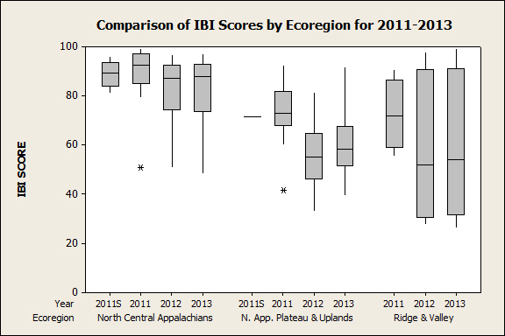
What about ecoregions?
Notes:
Differences between ecoregions – NCA lots of state forest lands, little ag NAPU – more developed, more ag, includes all of NY (glacial), RV only 6 sites, other influences (AMD, ag)

Slide 10
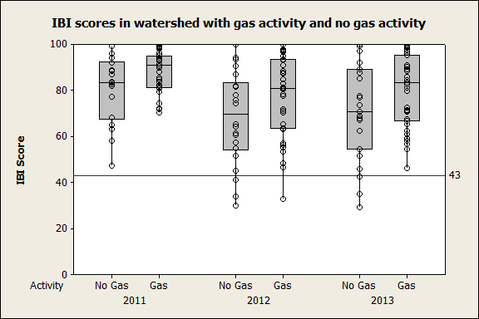
…and then what about gas development?
Notes:
Gas activity = at least one well within the drainage area of the sampling site Granted some watersheds may have other infrastructure development but that’s is not captured here

Slide 11
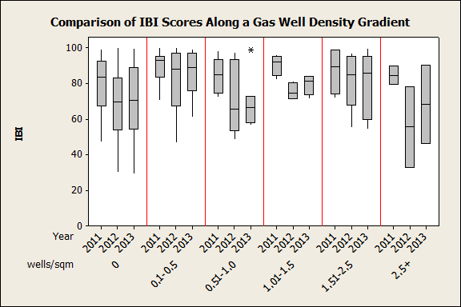
Result #2 Influence of well density
Notes:
Well pad vs well density . Well pad density shows similar pattern, even weaker relationship between pads than wells. well density ranges from 0-3.7 (Sugar Creek)

Slide 12
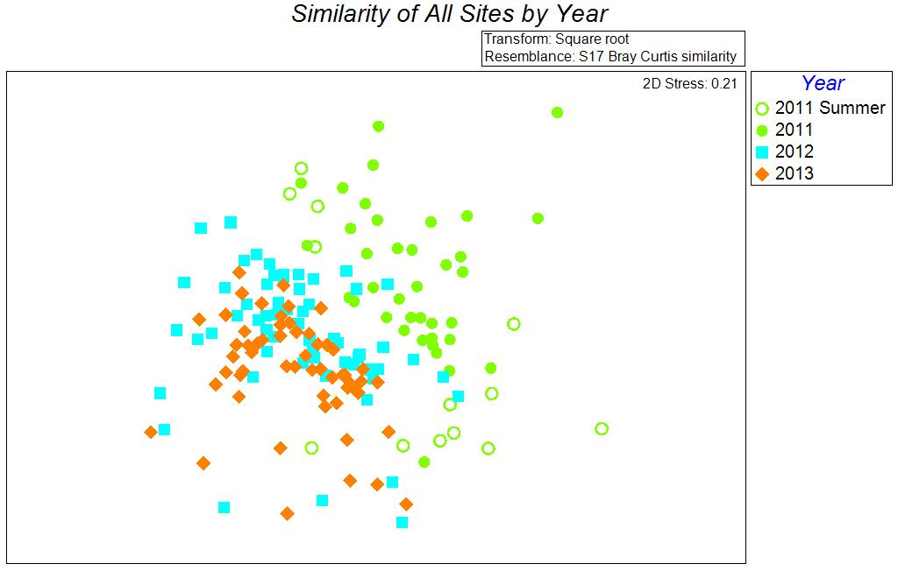
Result #3 2011 is different
Consistent grouping of 2011 apart from 2012 and 2013
Notes:
Did you notice in all of the previous graphs, regardless of ecoregion or gas/no gas, or well density 2011 IBI scores always higher. Are the communities that different?? YES Nonmetric Multidimensional scaling. Based on similarity indices which compare taxa and number. Sites that plot close to each other are most similar. 2011 clearly plots apart from 2012 and 2013

Slide 13
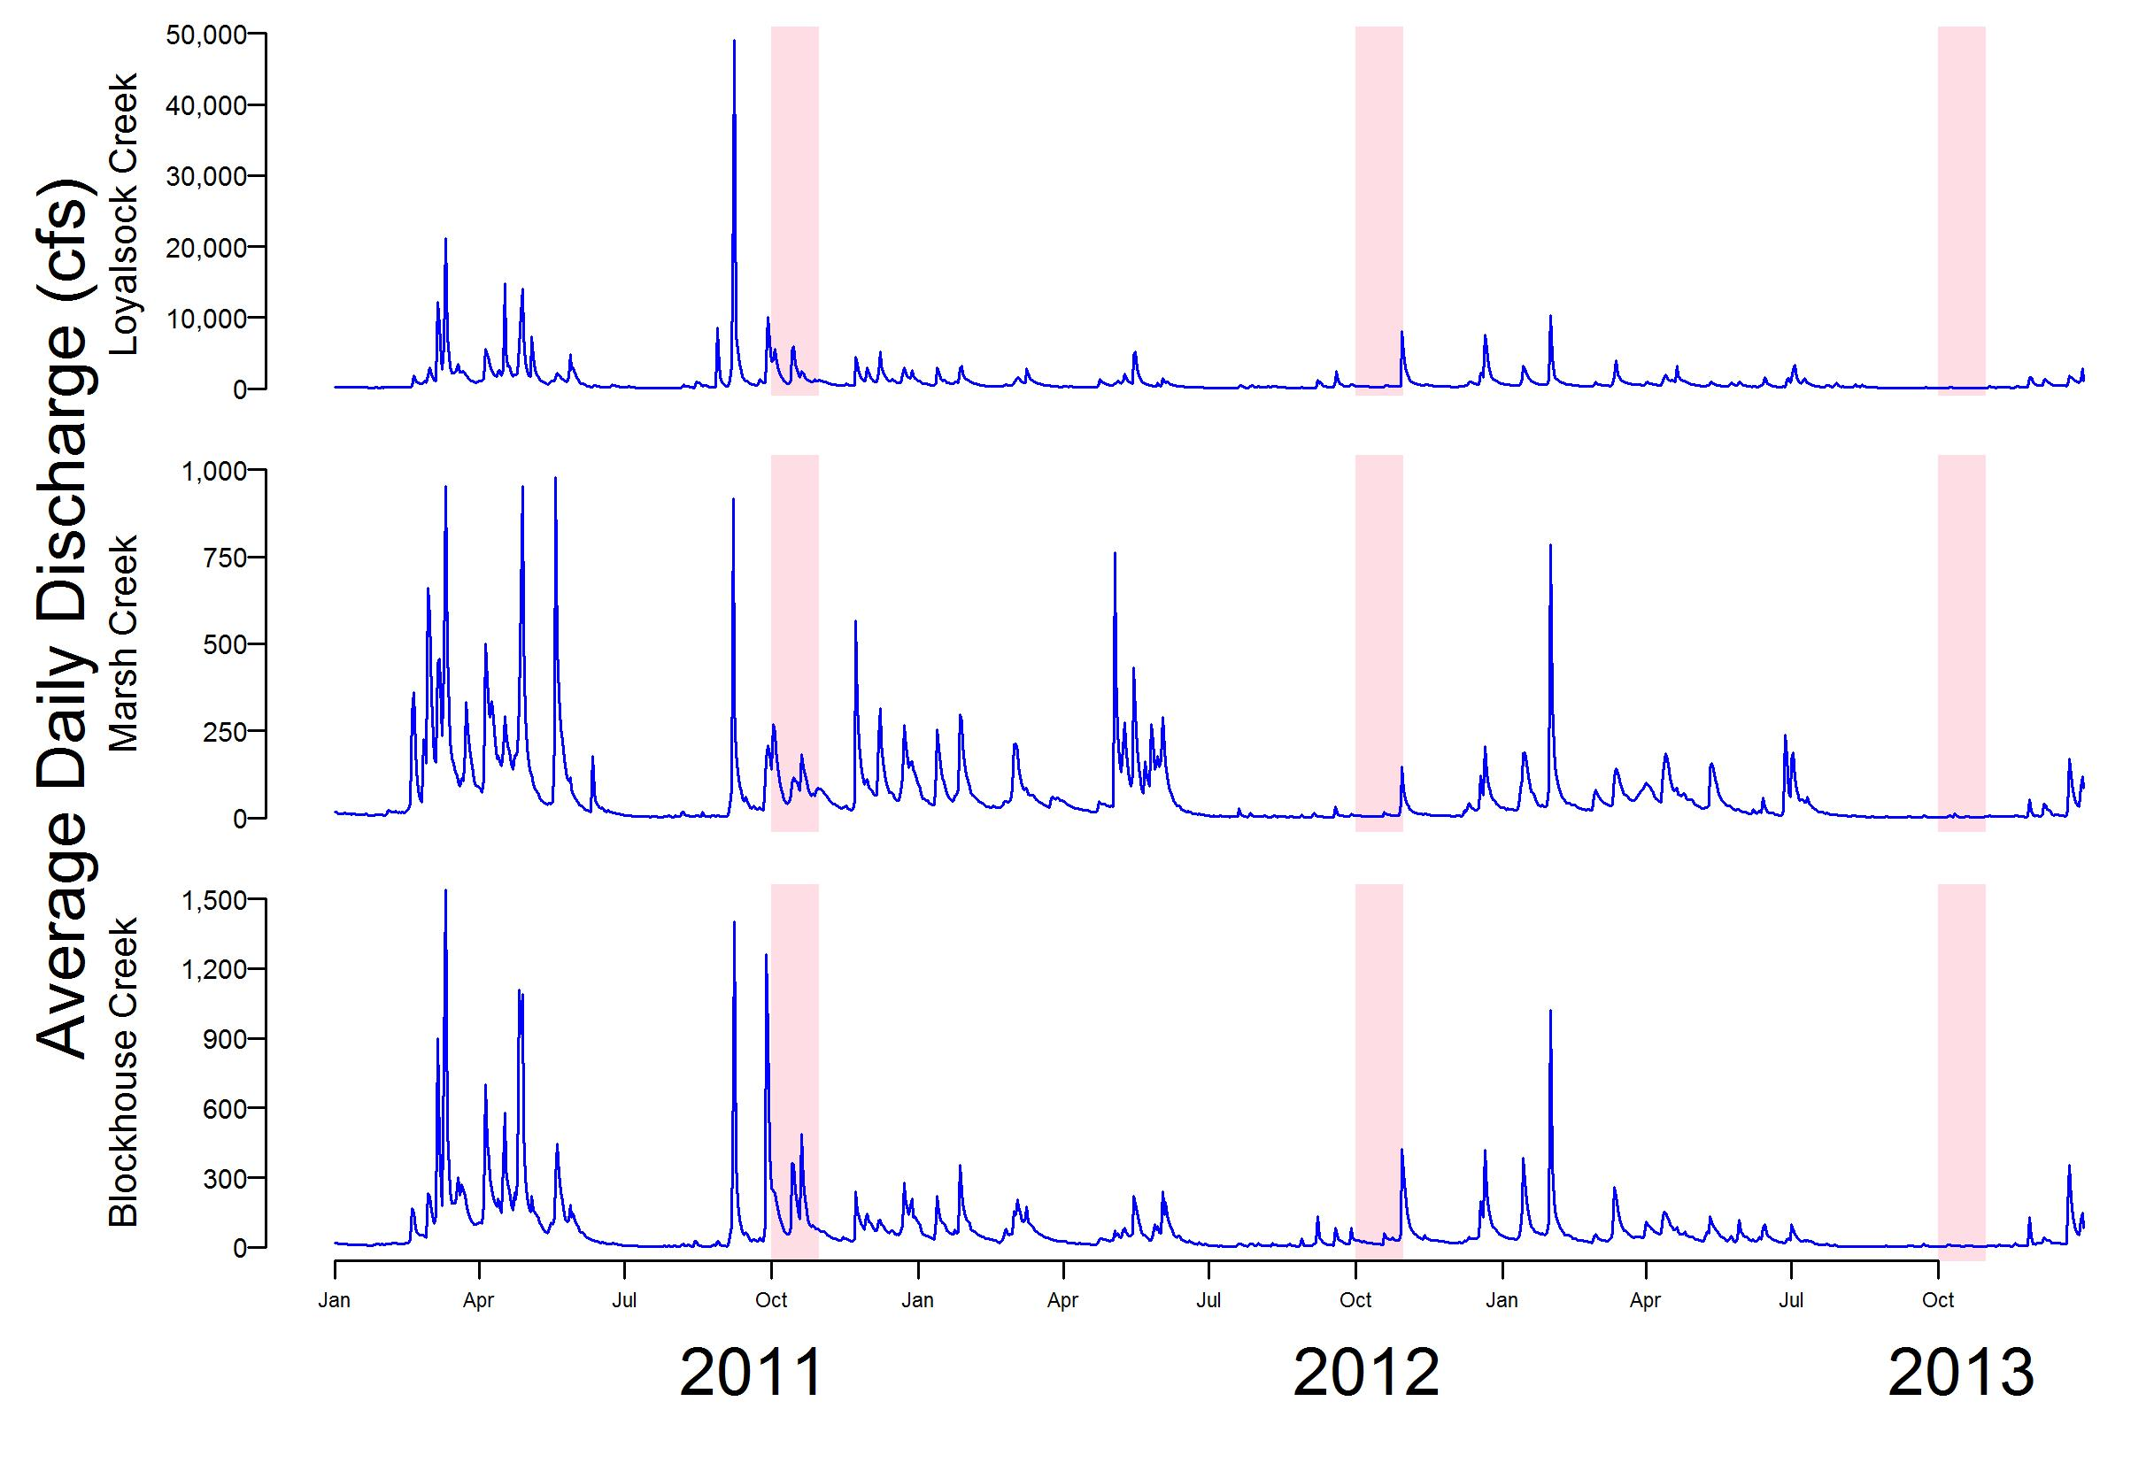
Notes:
Flow likely major contributor….seen similar patterns in other studies. Very wet year in 2011, including TS Lee and H. Irene a 6 weeks prior to sampling. Numerous large spring events….maybe washed out some sediment provided better substrate. Many more EPT, intolerant and low PTV taxa in 2011. specifically winter stoneflies in 2011

Slide 14
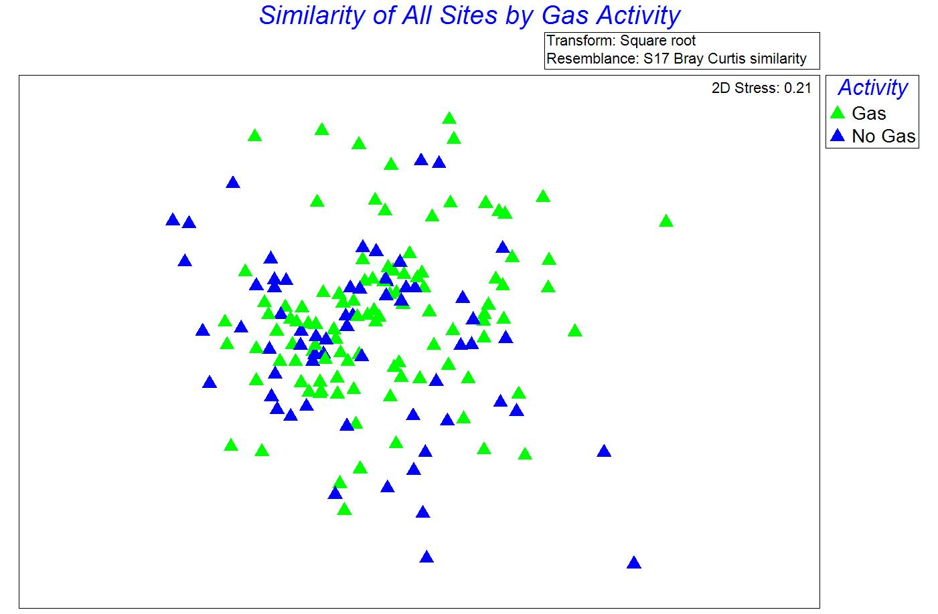
Result #4 Similarity of Assemblages in Gas vs No Gas

Slide 15
Wrap Up
More of the variation in IBI scores is explained by habitat score than by gas well metrics
gas well density
gas pad density
gas wells with a 4-mile radius of sampling location
As of 2013 data, there is no significant difference in biological communities in watersheds with no gas activity and those with gas activity.
Healthy streams with sufficient habitat to support thriving macroinvertebrate communities
NOT an indication that gas development can not or will not have negative impacts on stream biota
Long term cumulative effects more likely, except for acute events such as spills

Slide 16
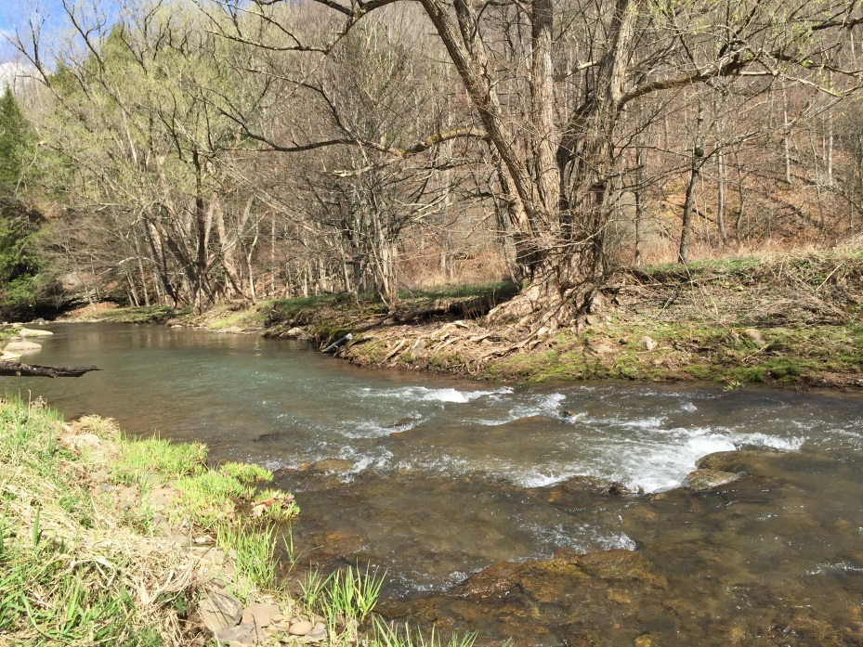
Upcoming Work
2014 macroinvertebrate samples are back
2015 October sampling at all sites
22 sites are on stream sections designated as EV or HQ CWF
Sampling in April/May
Most designations came before Marcellus drilling
Have things changed?
More research into impacts of
flow patterns on macroinvertebrate communities
Investigate other ways and scales to evaluate gas development.
Notes:
EV/HQ about done, looking at other data sets to see similar flow related trends, low flow monitoring

Slide 17
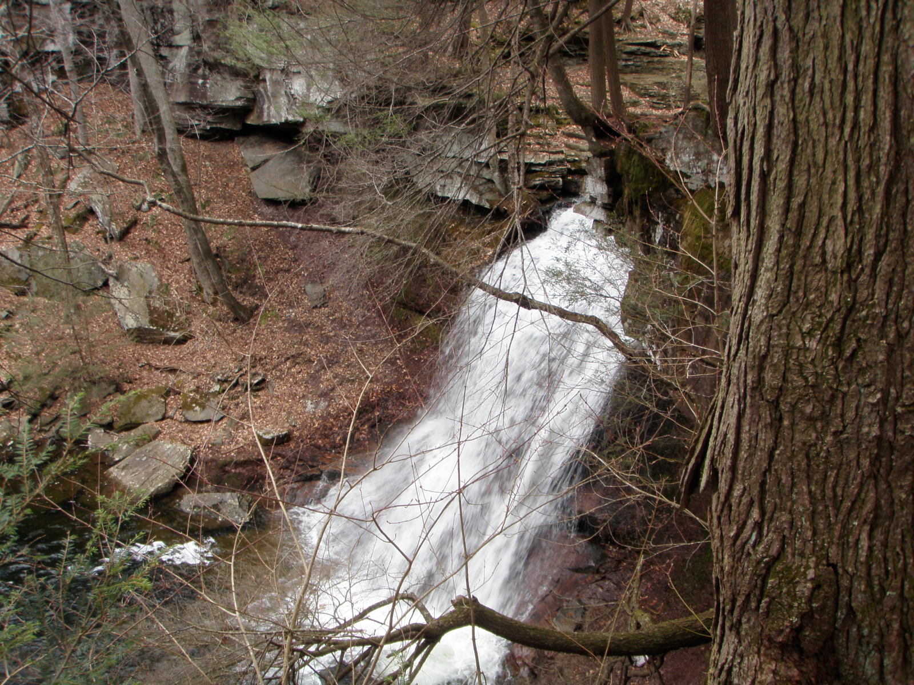
Questions?
Luanne Steffy lsteffy@srbc.net
General questions on RWQMN – Dawn Hintz, Project Manager dhintz@srbc.net
RWQMN Website http://mdw.srbc.net/remotewaterquality/

